Slide 1
Used for highlighting a key portion of portion of the user interface
Menus
Used for highlighting a step (step 2 in this example)
2
All screenshots from PowerPoint taken with zoom level in PowerPoint at 100%
All screenshots from other applications are scaled to 75% in PowerPoint. Other scales can be used when necessary for clarity.
User Task
Decision
Yes
Program Task
Start
End
No
+
Fork/Join

Slide 2
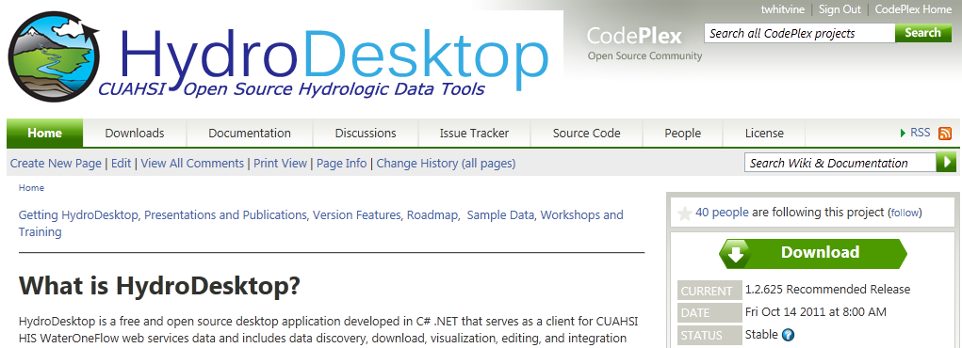
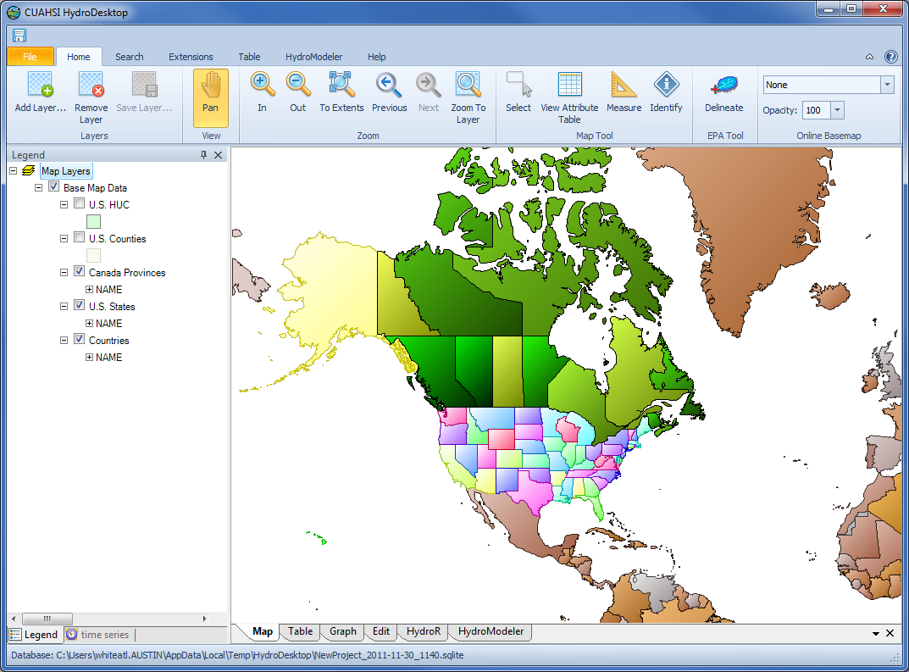
Ribbon
Map
Legend

Slide 3
Start
Select Area (where)
Select Keyword(s)
(what)
Select Time Range
(when)
Select Source(s)
(who)
Run Search
Download Data
End

Slide 4
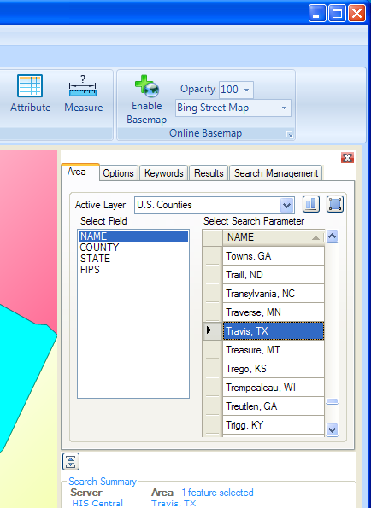
1
2

Slide 5
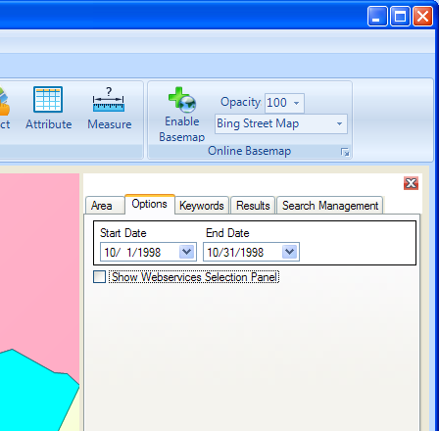
3
4

Slide 6
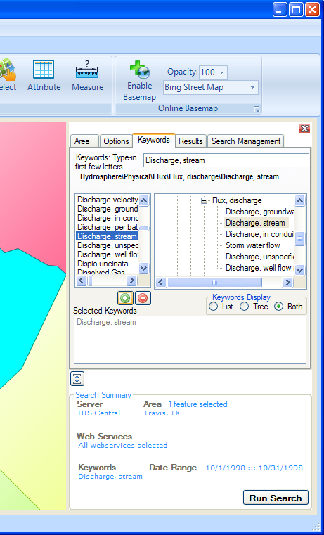
5
6
7
8
9

Slide 7
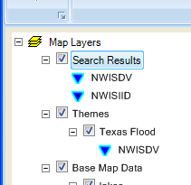

Slide 8
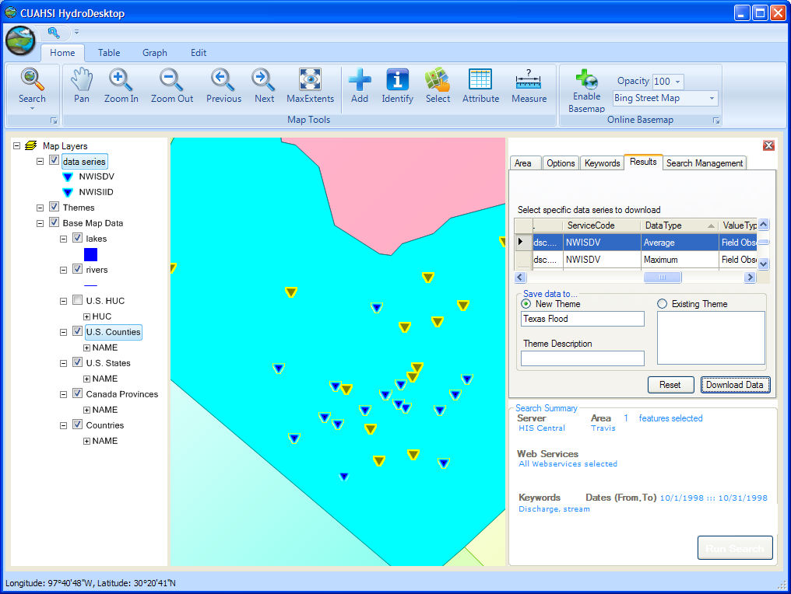
11
12
10
13
14

Slide 9
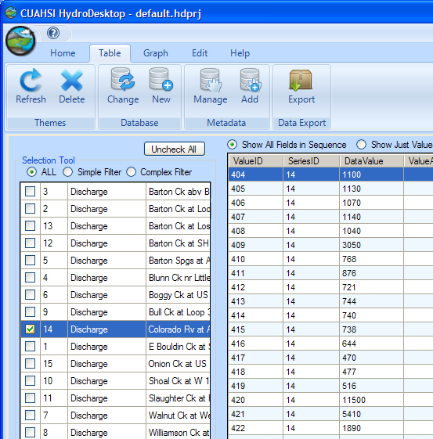
1
2

Slide 10
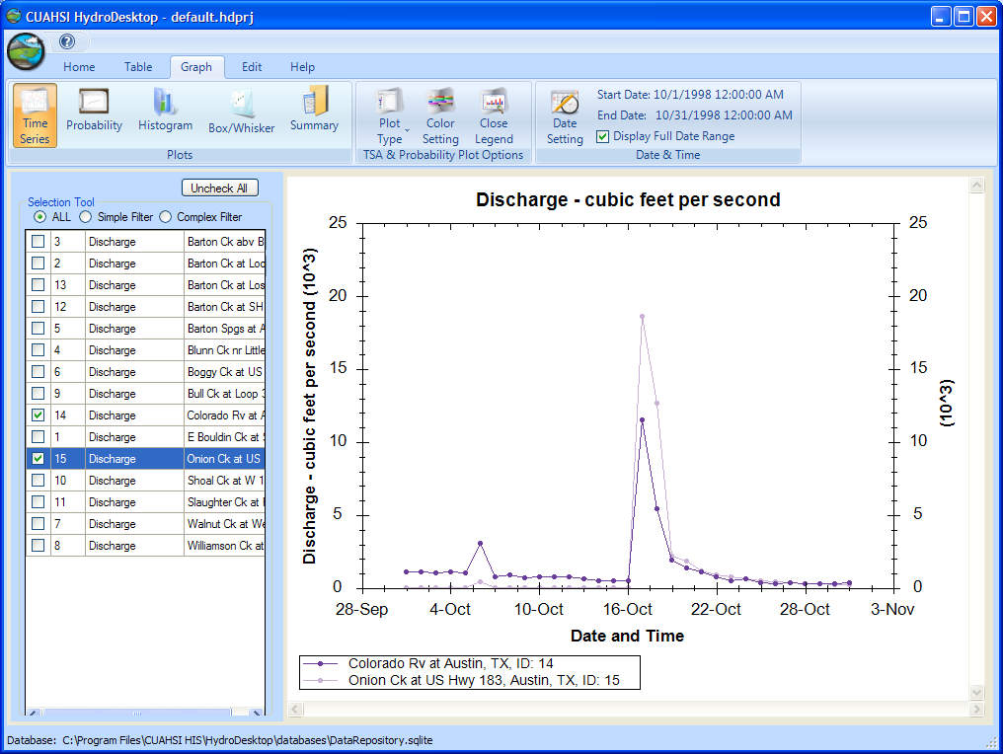
3
4

Slide 11
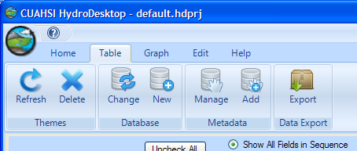
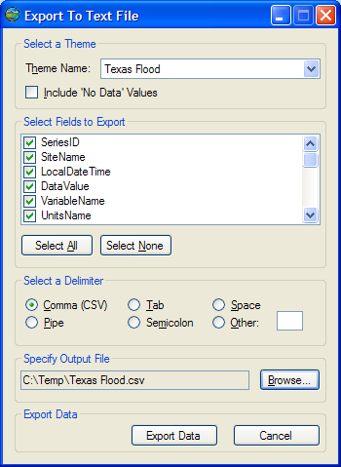
1
2
3
4

